Slide 1
Final Meeting 9/28
Ainsley Lai

Slide 2
Agenda
Searching for MMSI with large speed range (diff. of 3 knots between min/max speed), at least 15 km from a hydrophone
https://github.com/ainsleylaiuw/OcDa-Files

Slide 3
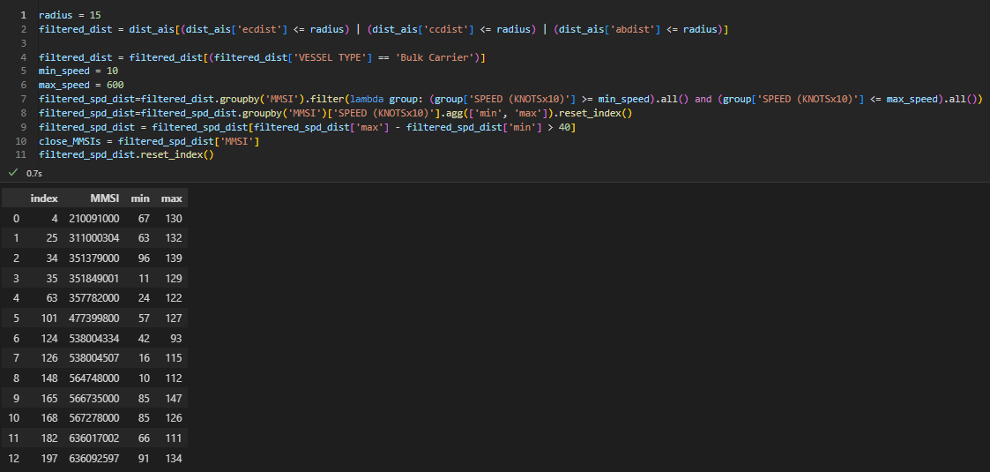
Method
Filter to rows that are within 15km of one hydrophone
Filter to Bulk Carriers
Find rows that have a diff. of 4 knots between min and max speed
MMSI index 6-9 best candidates
Based on amount of data

Slide 4
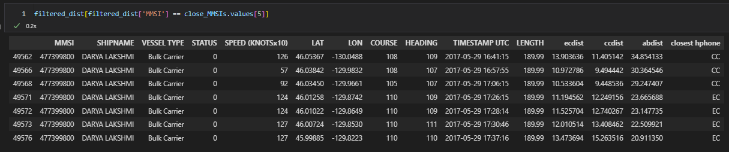
Method
Filter to rows that are within 15km of one hydrophone
Allows us to track ships as they move ‘across’ hydrophones
Filter to Bulk Carriers
Find rows that have a diff. of 4 knots between min and max speed

Slide 5
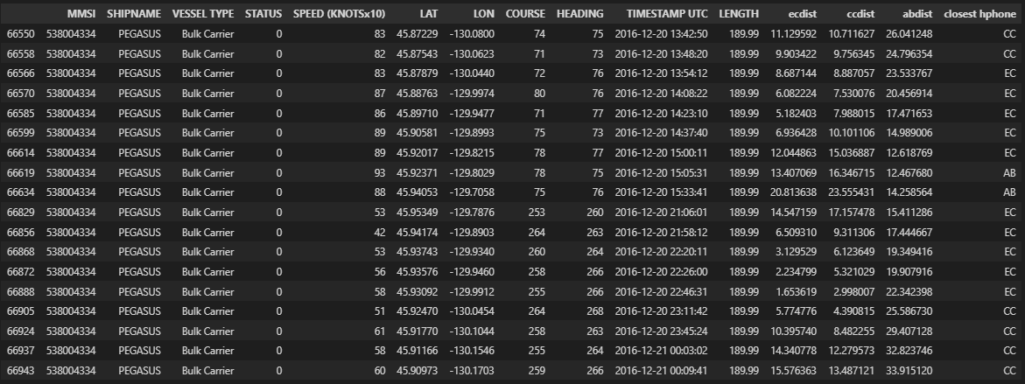
MMSI Index 6

Slide 6
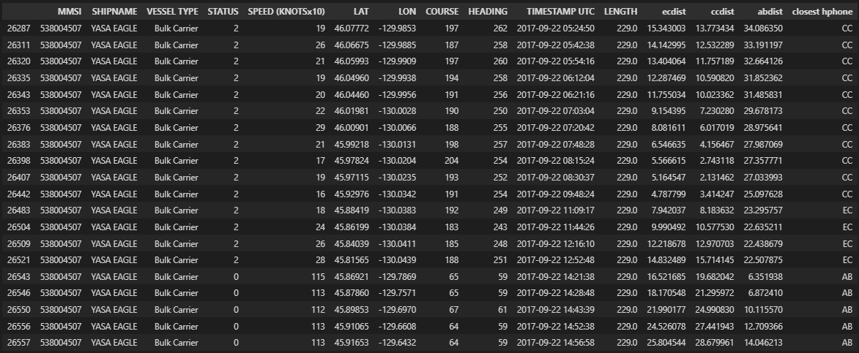
MMSI Index 7

Slide 7
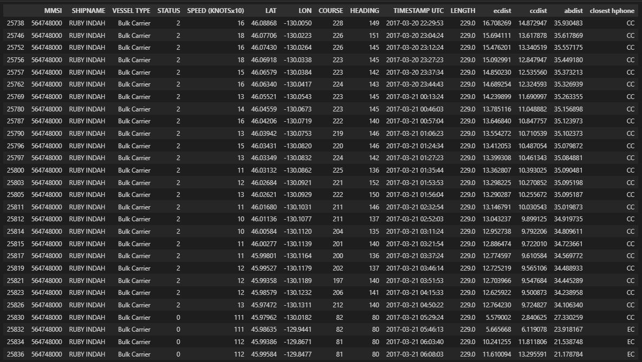
MMSI Index 8

Slide 8
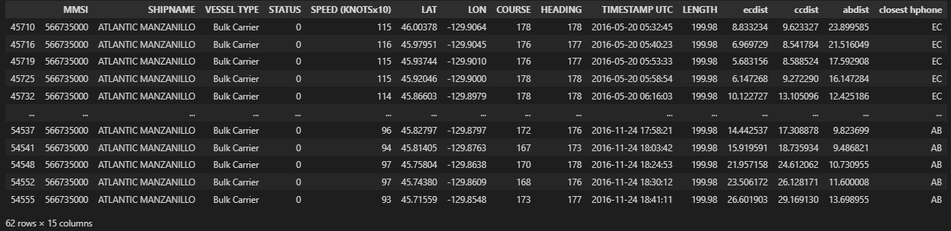
MMSI Index 9

Slide 9
Code Repo Changes
https://github.com/ainsleylaiuw/OcDa-Files
Added nb3functions.py file with comments for each function
Updated header comment in NB_3.ipynb, the most recent notebook of work (investigation of individual MMSIs and MMSI identification (first agenda identification)) to include a description of the notebook purpose
Updated repo README to include short description of files/notebooks

